Slide 1
CosmI Code
WEEK-4
ABDULLAH IMRAN

Slide 2
01
Implement a simple feedforward neural network from scratch using NumPy.
Train it on a small dataset.

Slide 3

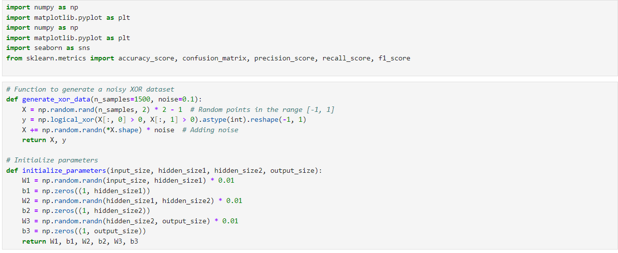
Importing Libraries & Writing Functions

Slide 4
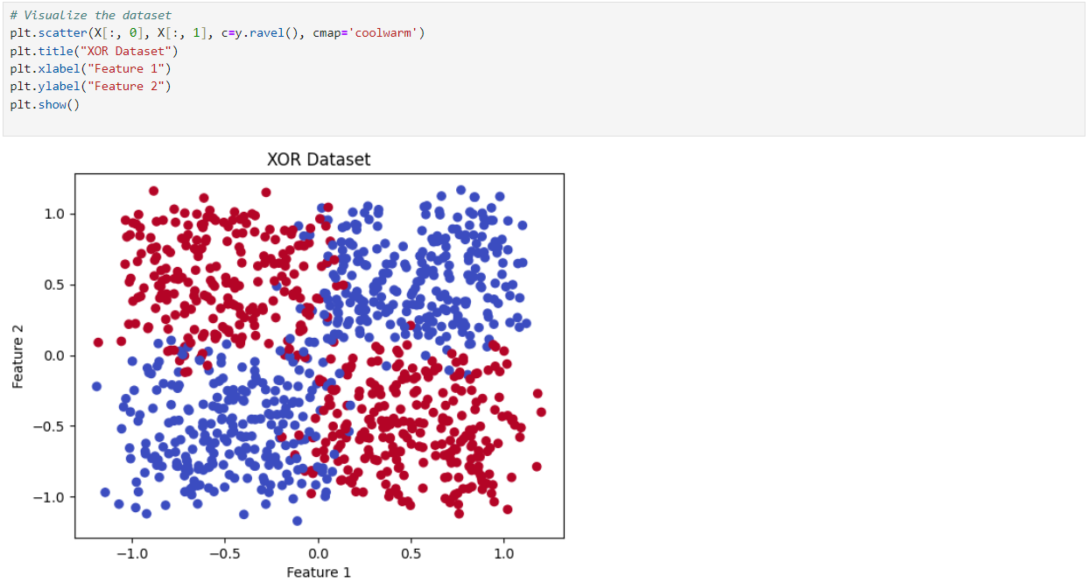
Dataset Visualization

Slide 5
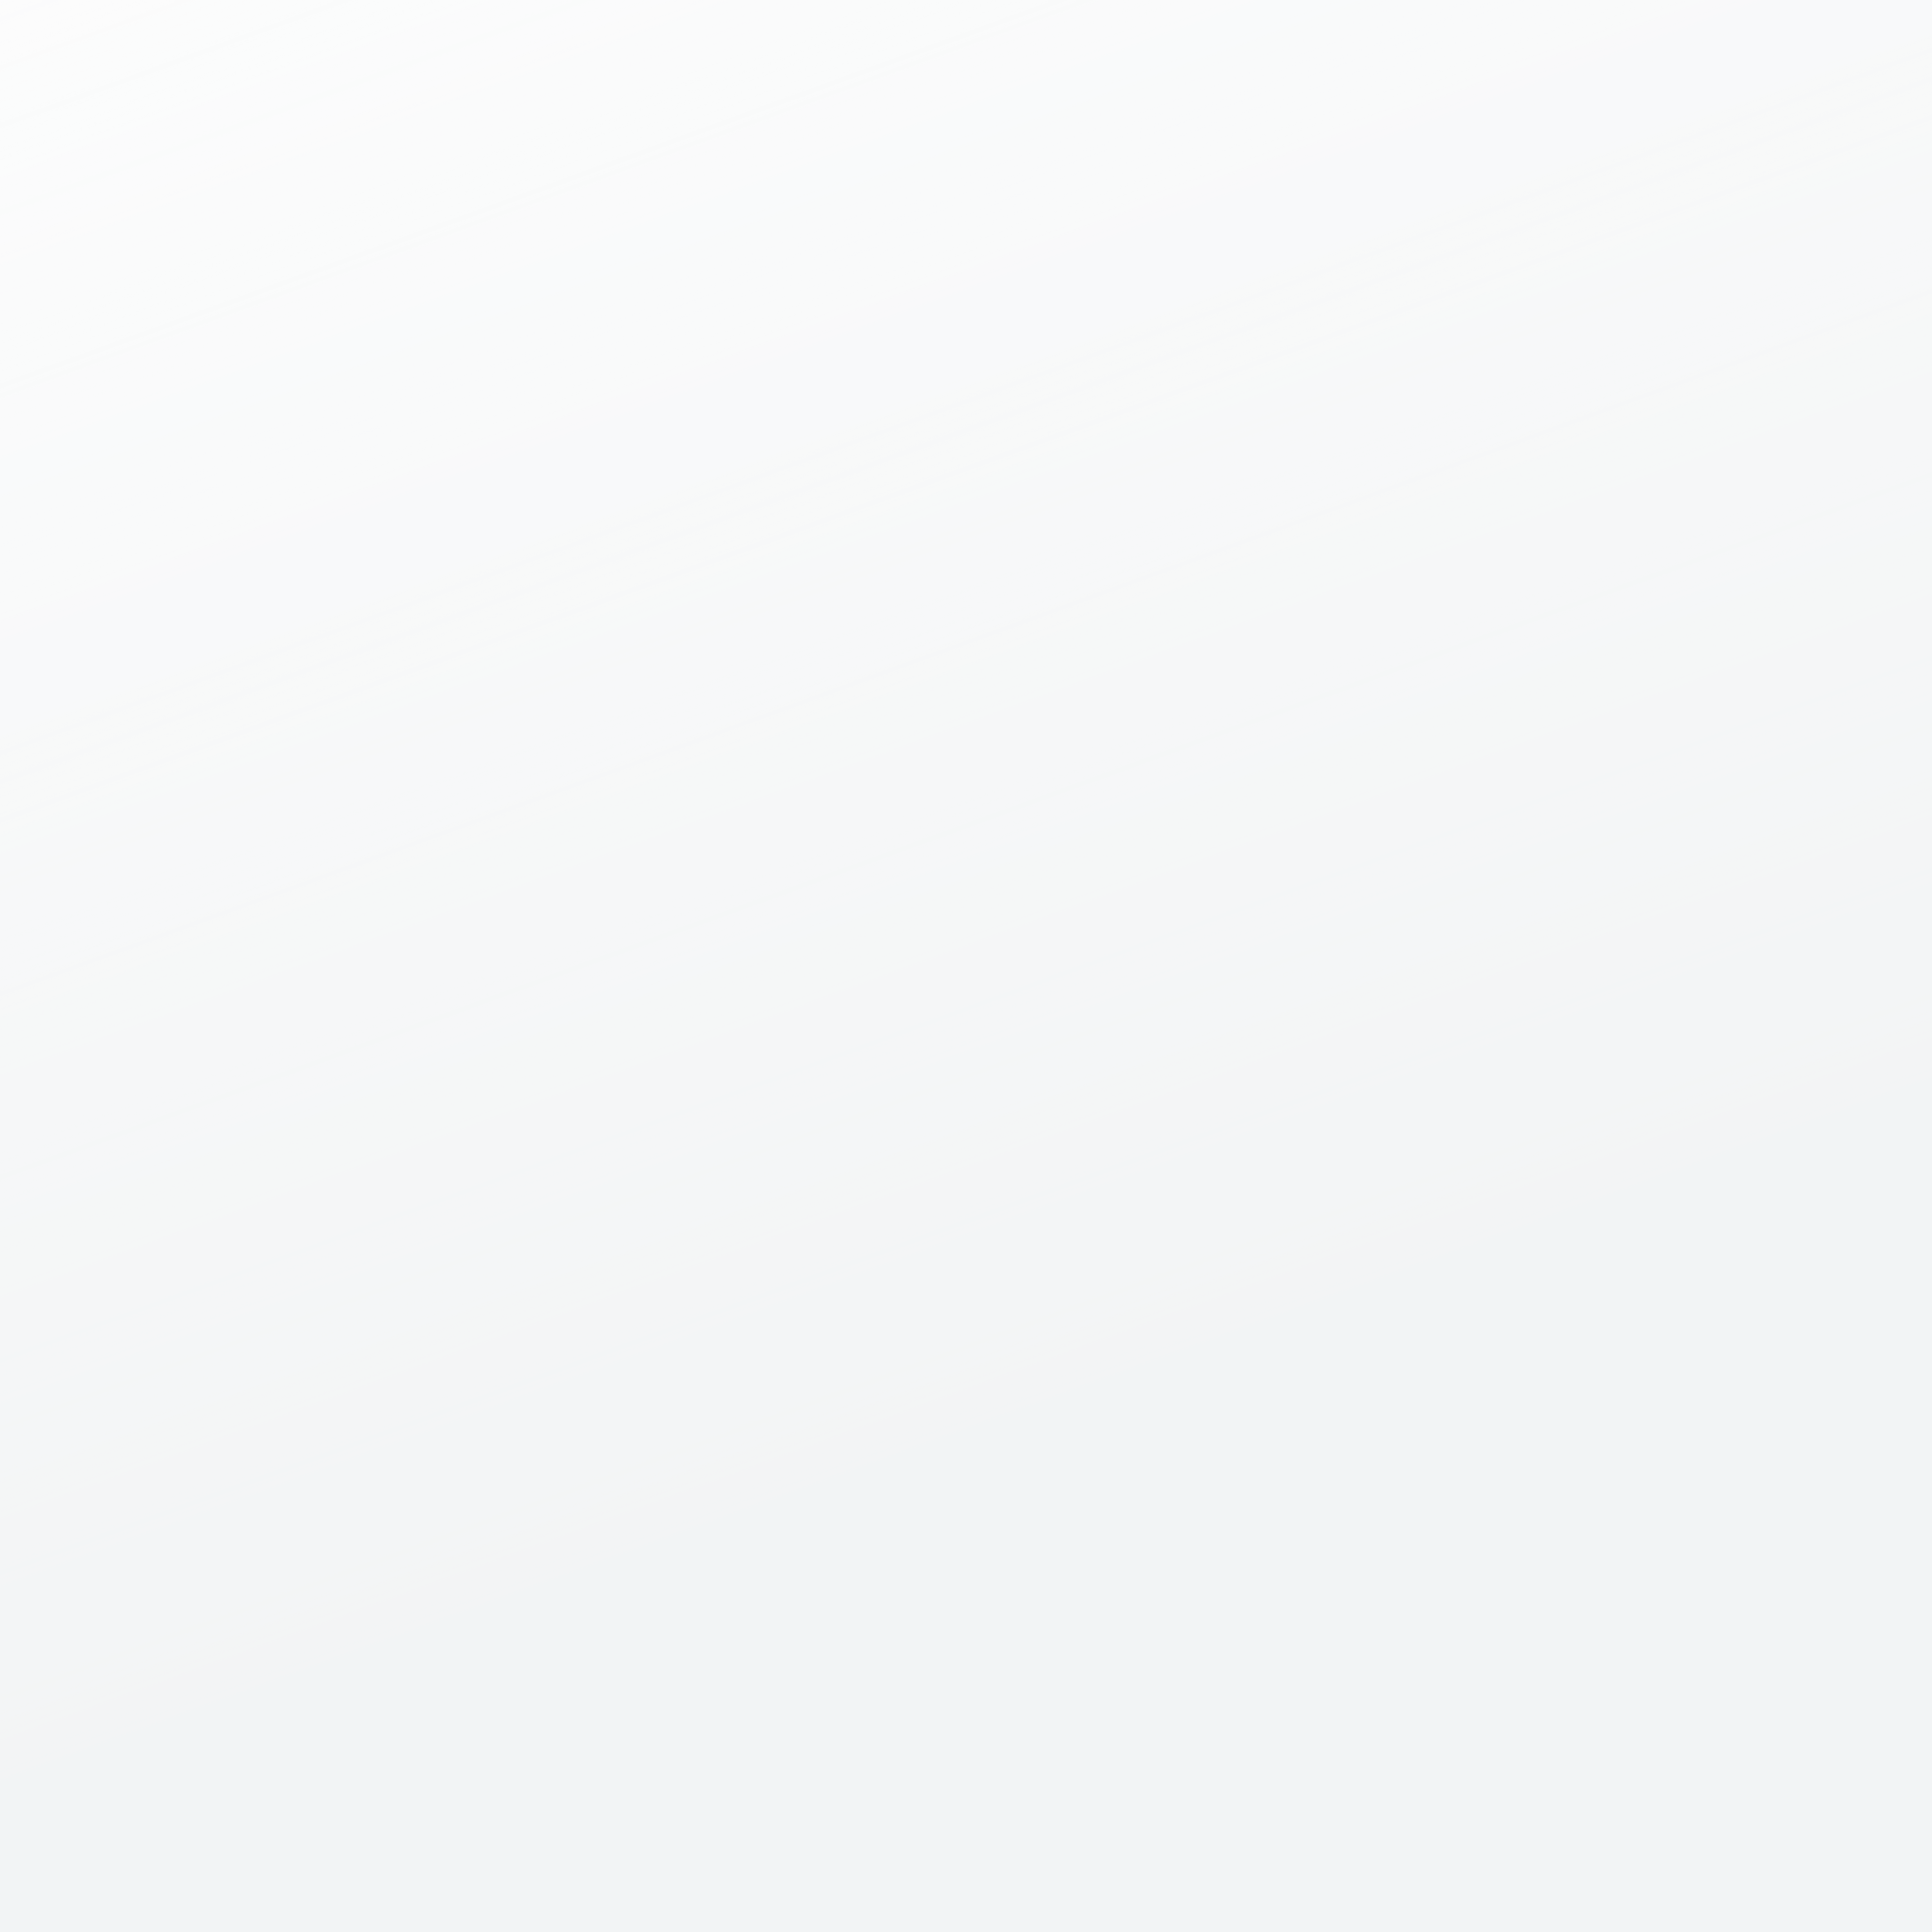
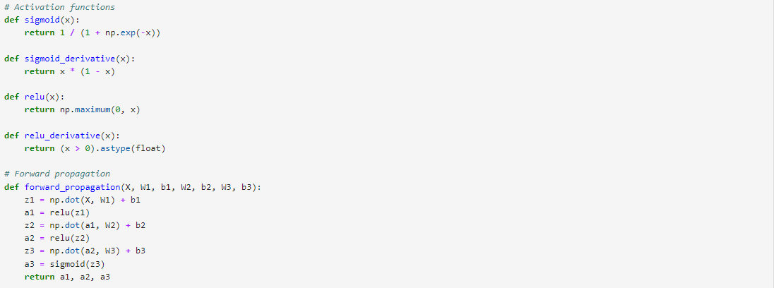
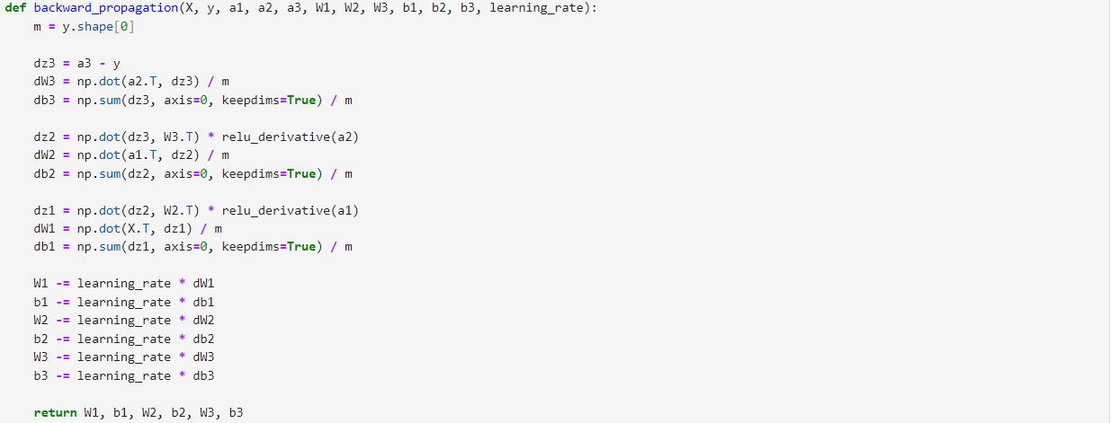
Models Functions

Slide 6
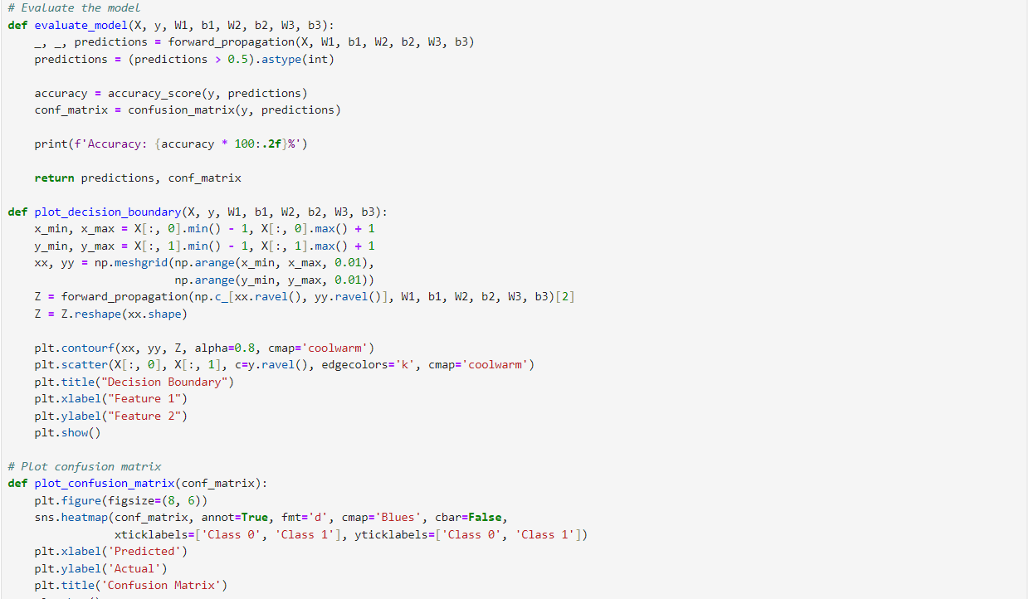
Evaluation Functions

Slide 7
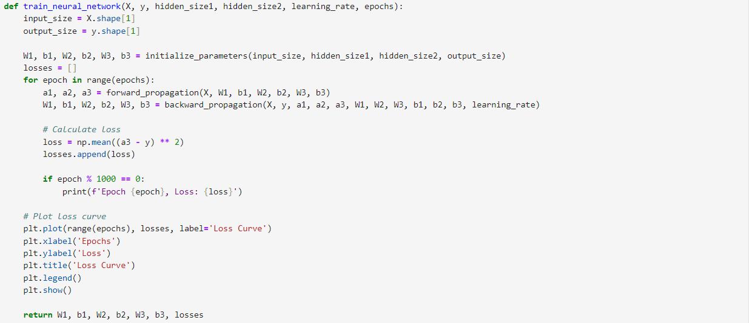
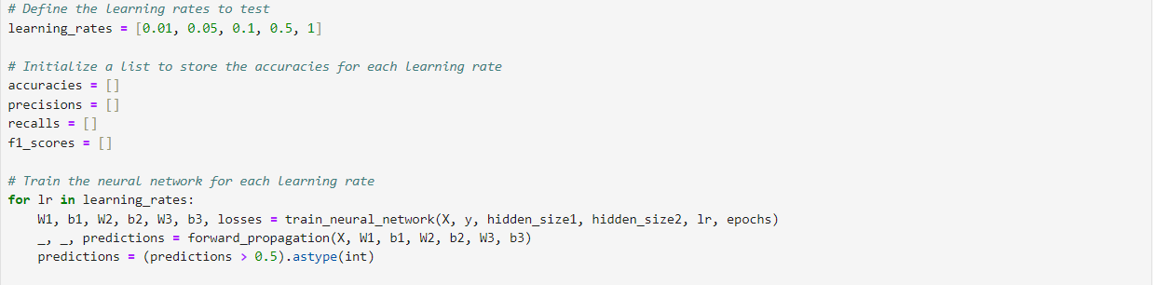
Neural Networks Fucntions

Slide 8
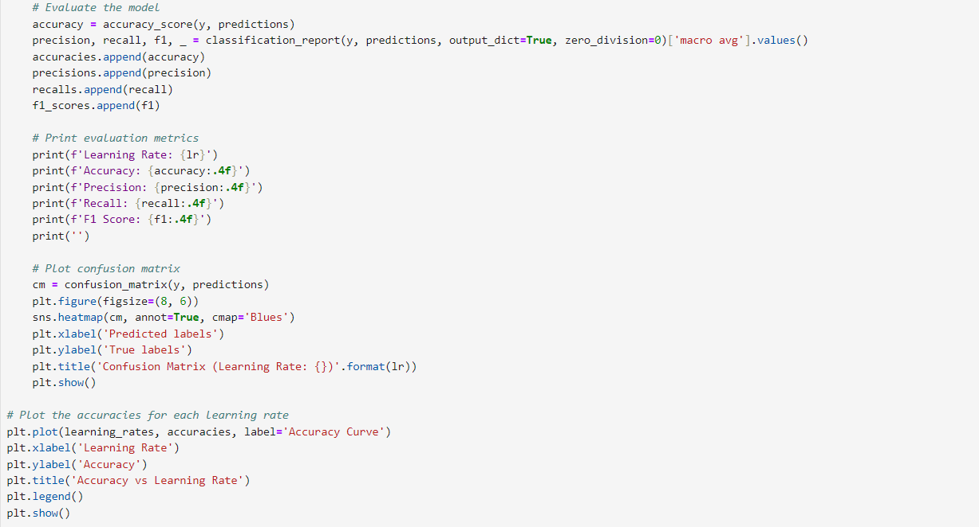
Evaluation

Slide 9
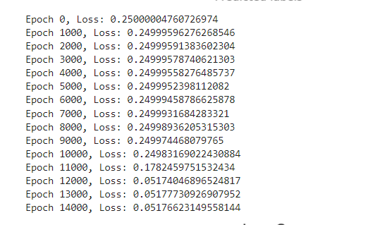
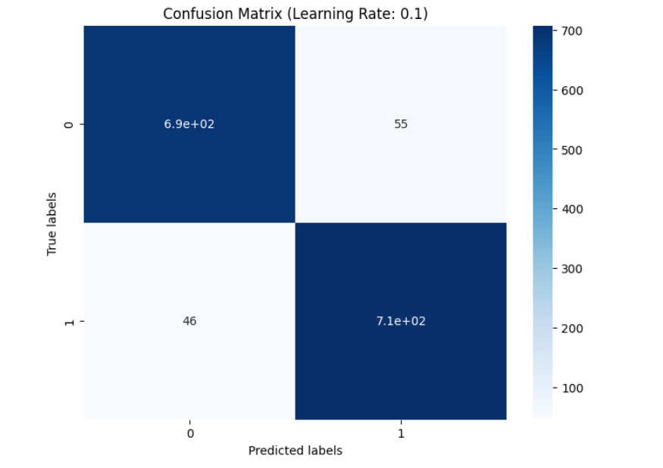
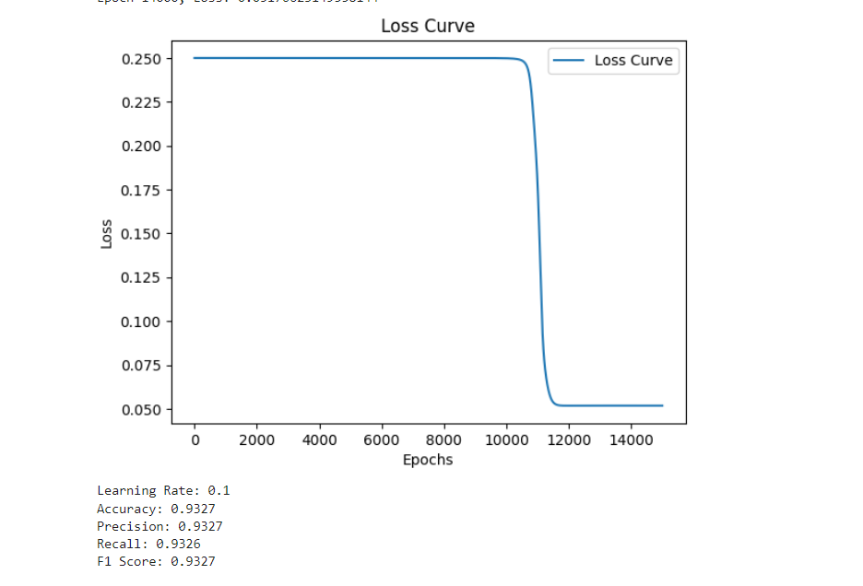
Best Learning Rate Results

Slide 10
02
Build a deep neural network using
Tensor-Flow/Keras.
Train it on the MNIST dataset for digit classification.

Slide 11
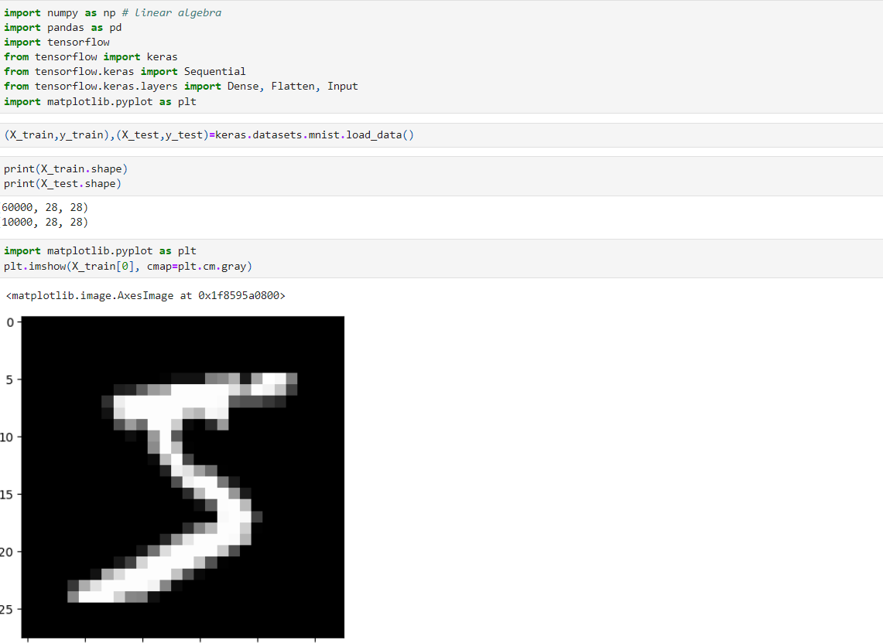
Dataset Loading And Previewing
Question No.2

Slide 12
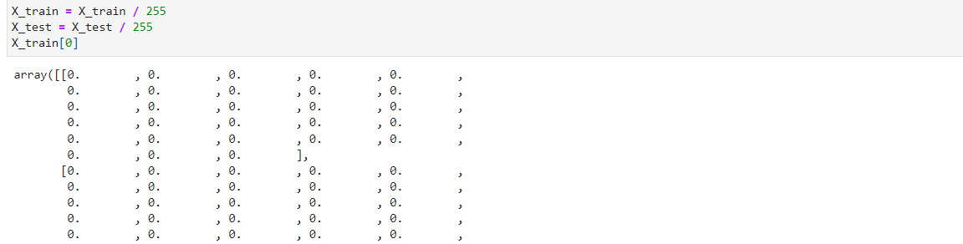
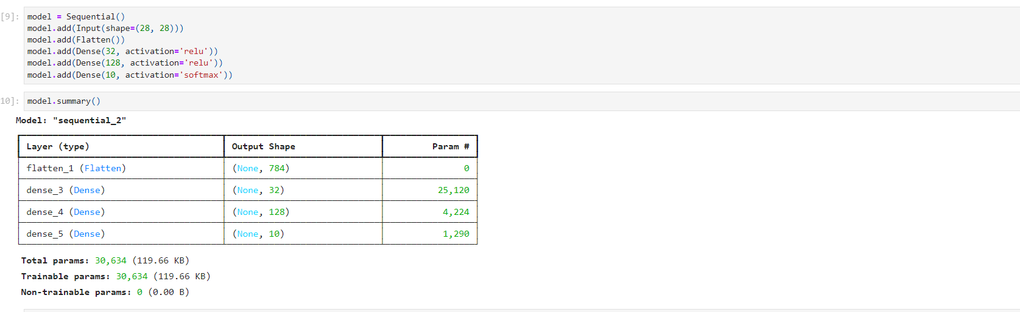
Normalizing Data
Model Buidling

Slide 13
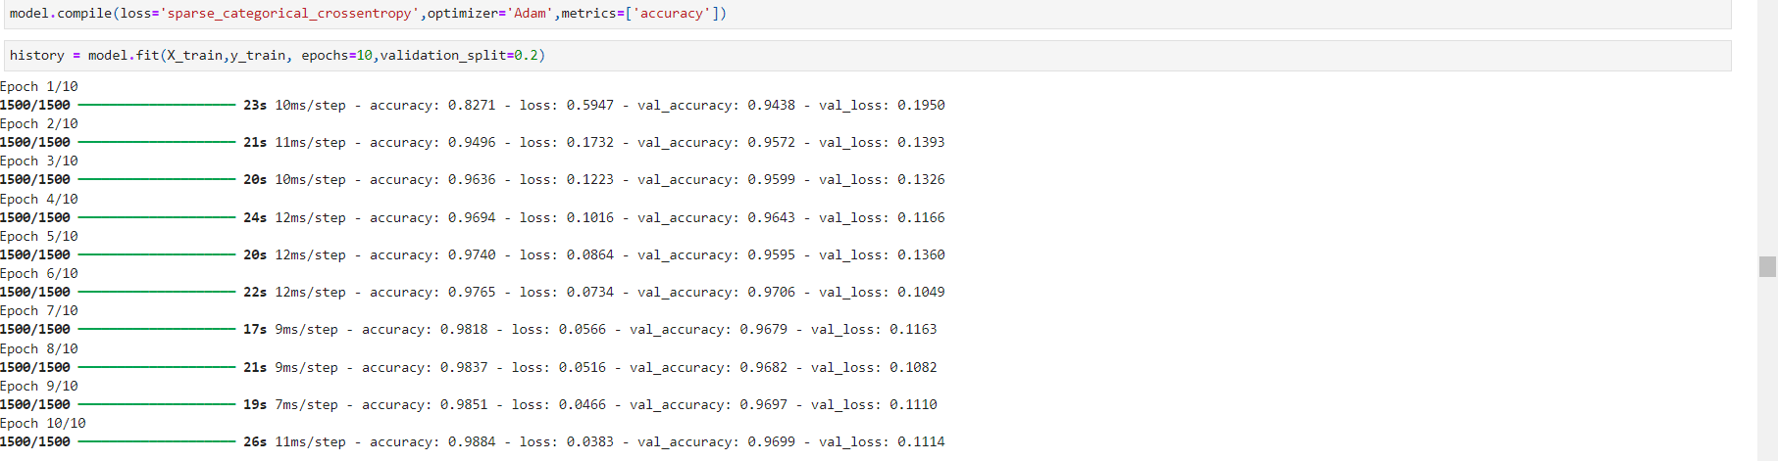
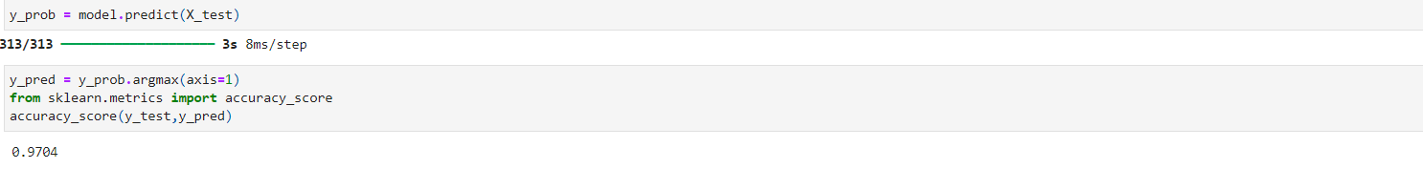
Model Training & Testing

Slide 14
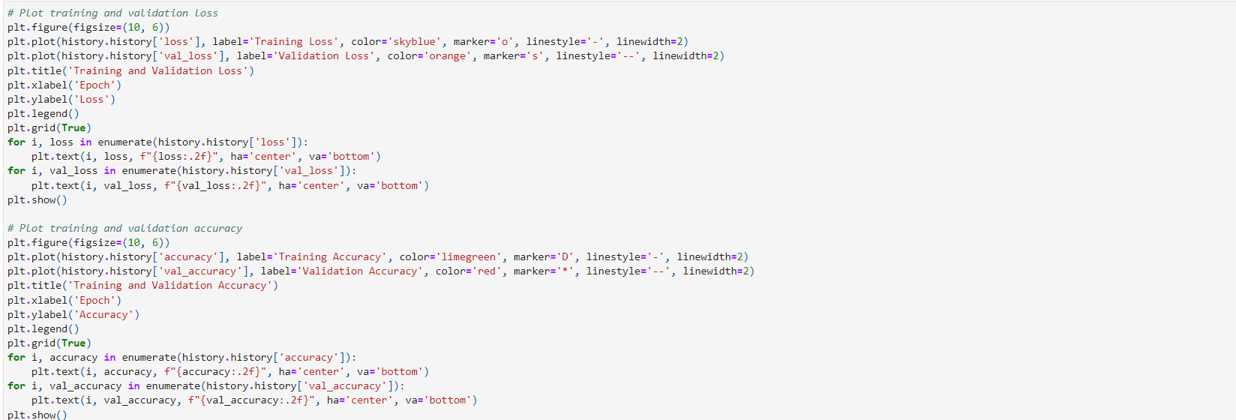
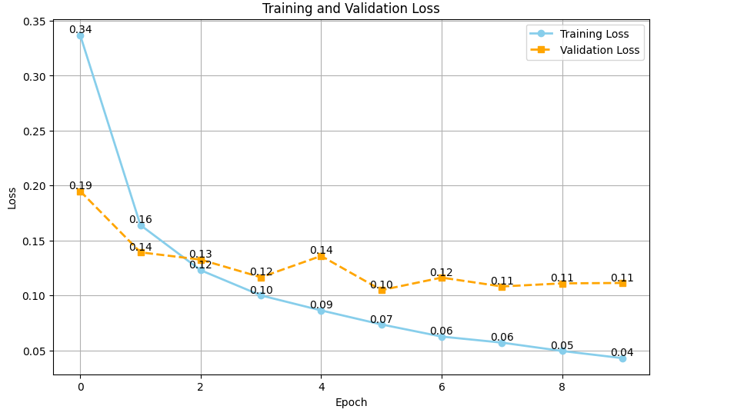
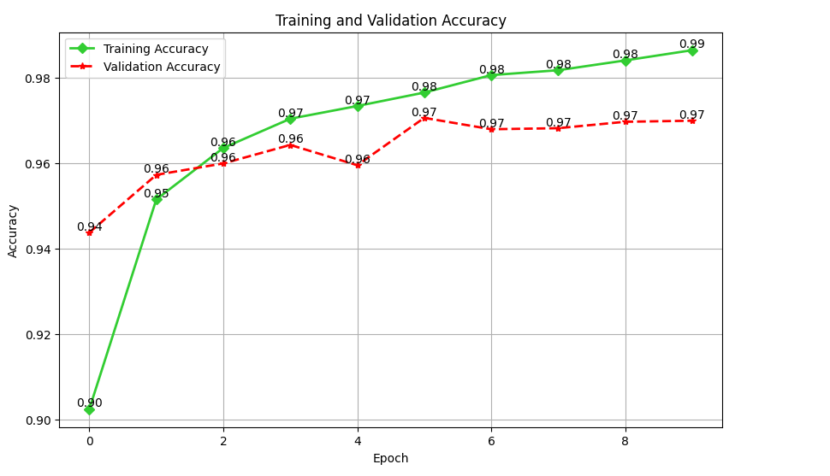

Slide 15
03
Implement regularization techniques (dropout, L2 regularization) to prevent overfitting in neural networks.

Slide 16
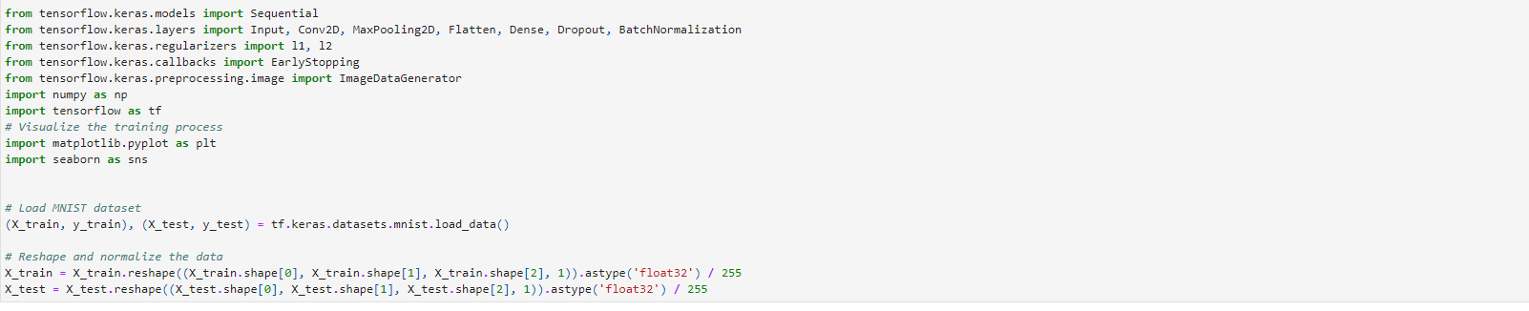
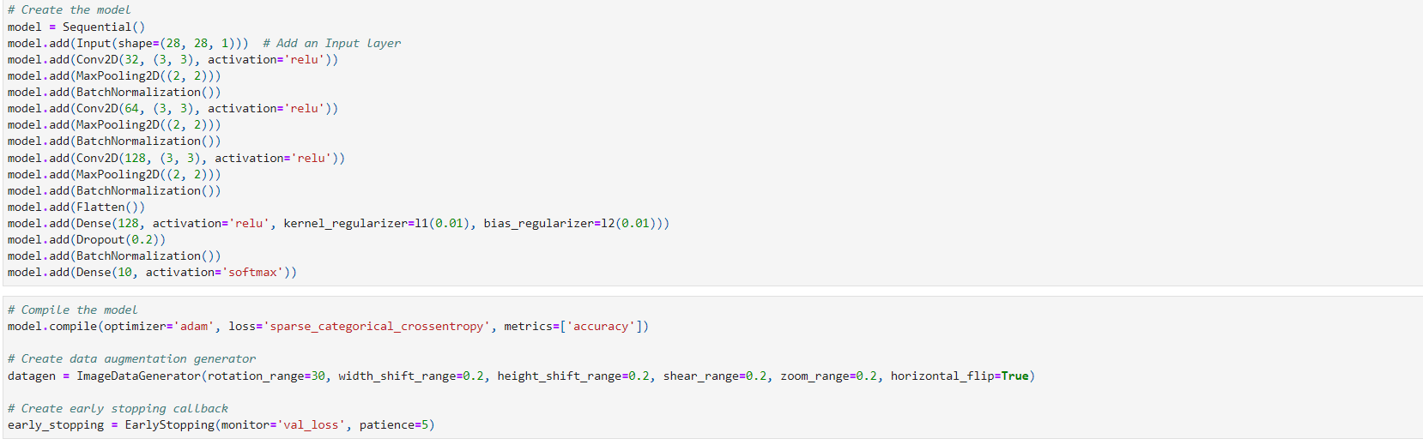
Dataset Loading & Model Building

Slide 17
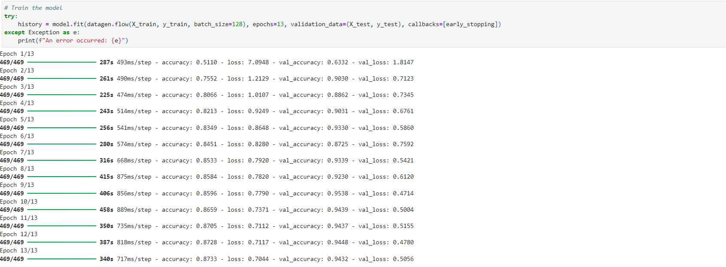
Training & Testing
Finding Accuracies & Plotting Them

Slide 18
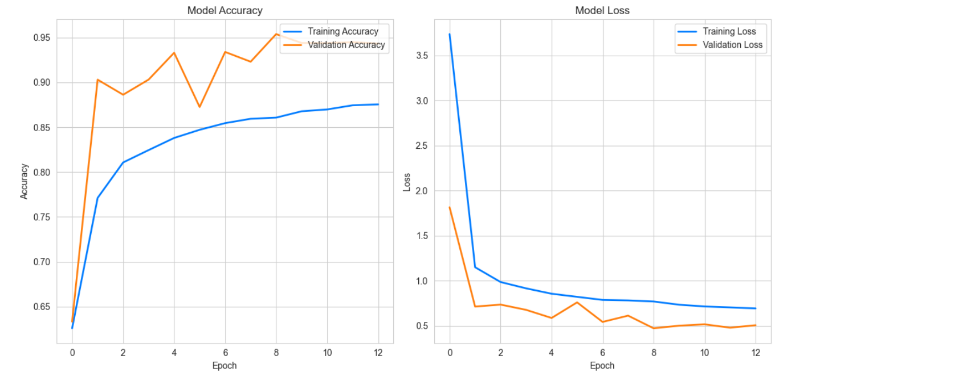
Plotting Model Loss & Accuracy

Slide 19
04
Build and train a convolutional neural network (CNN) on the CIFAR-10 dataset.
Achieve at least 70% accuracy.

Slide 20
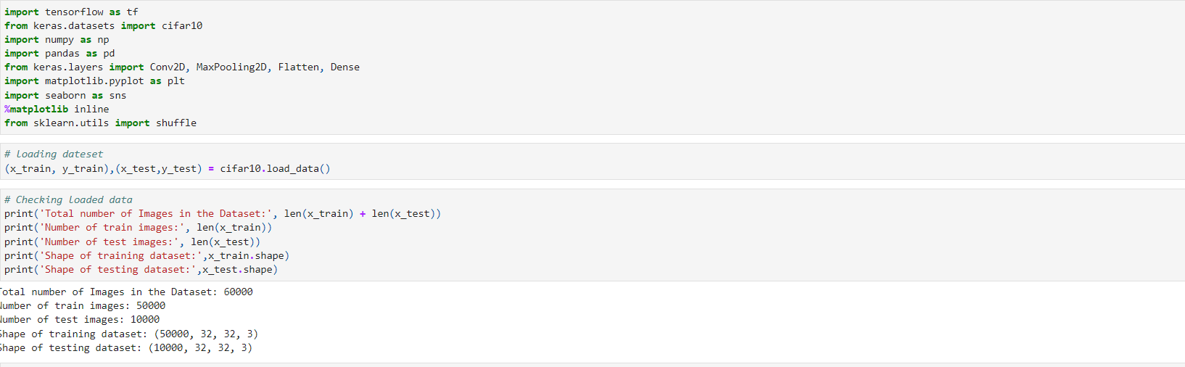
Importing Libraries, Data & Viewing It

Slide 21
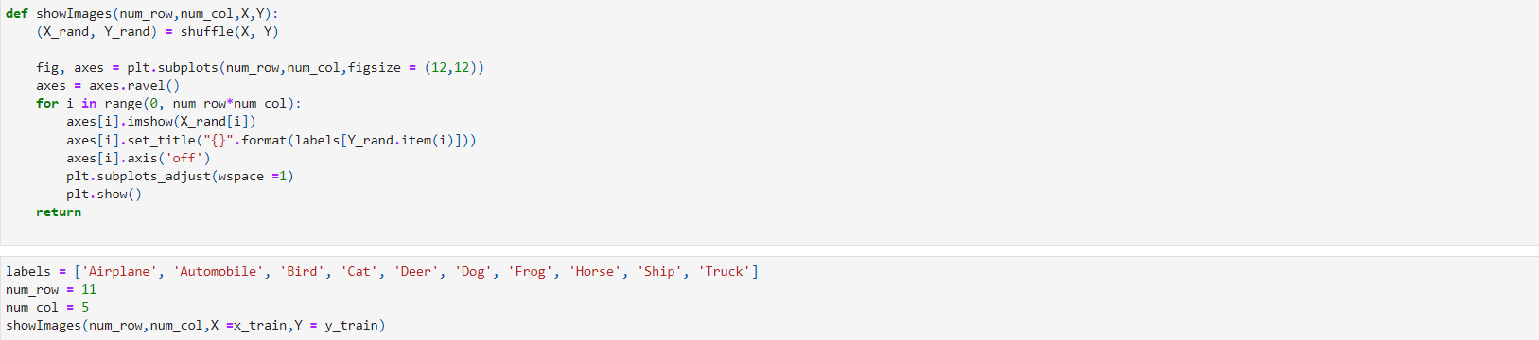
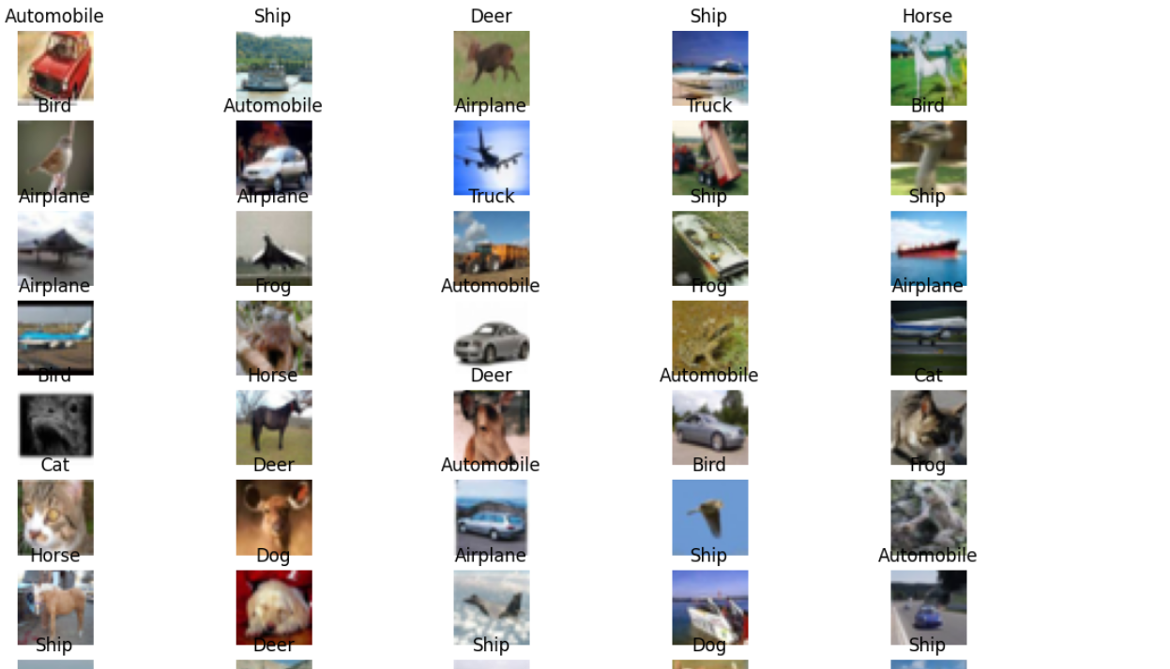
Viewing Images In Data

Slide 22
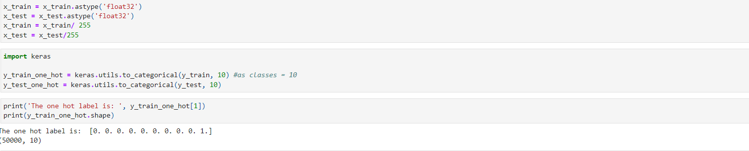
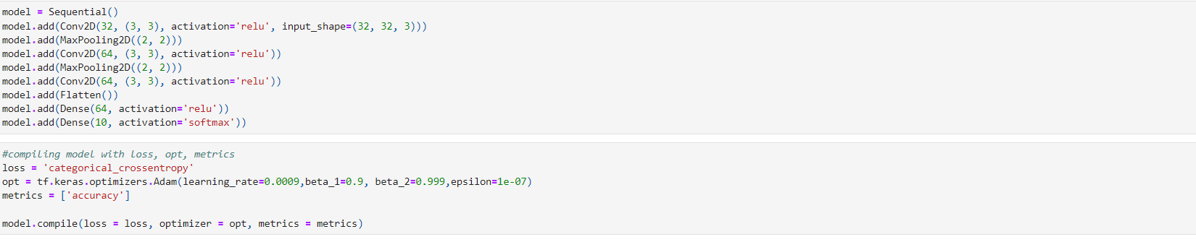
Dataset Loading & Model Building
Model Building

Slide 23
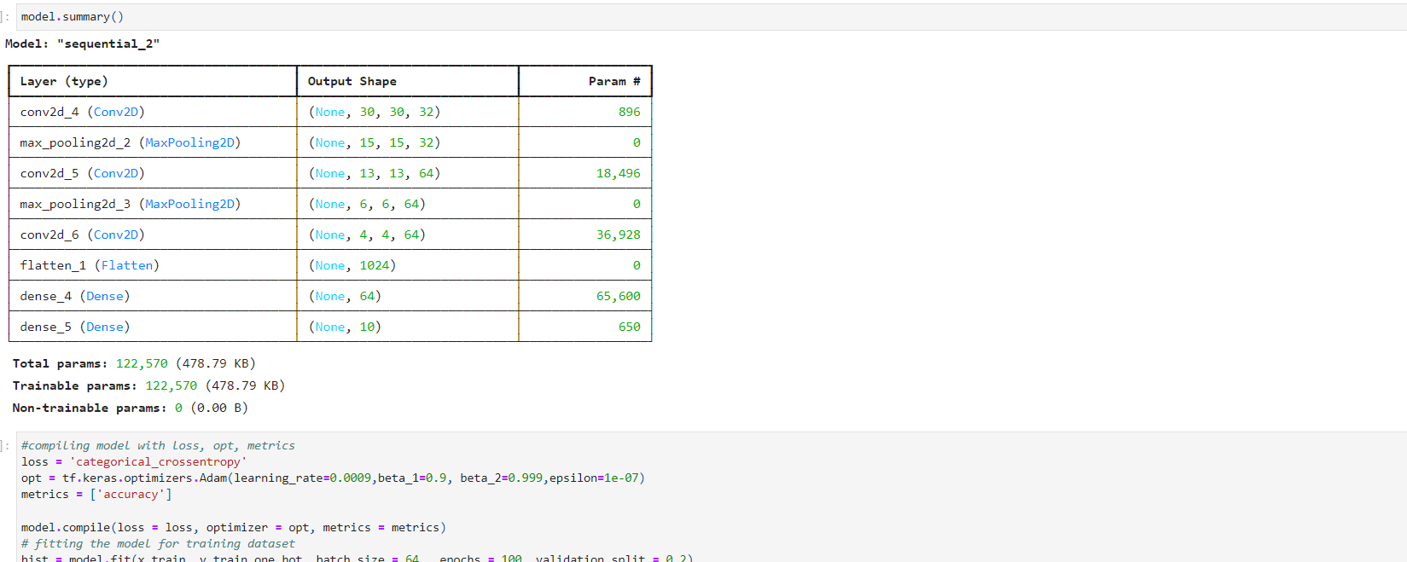
Model Summary

Slide 24
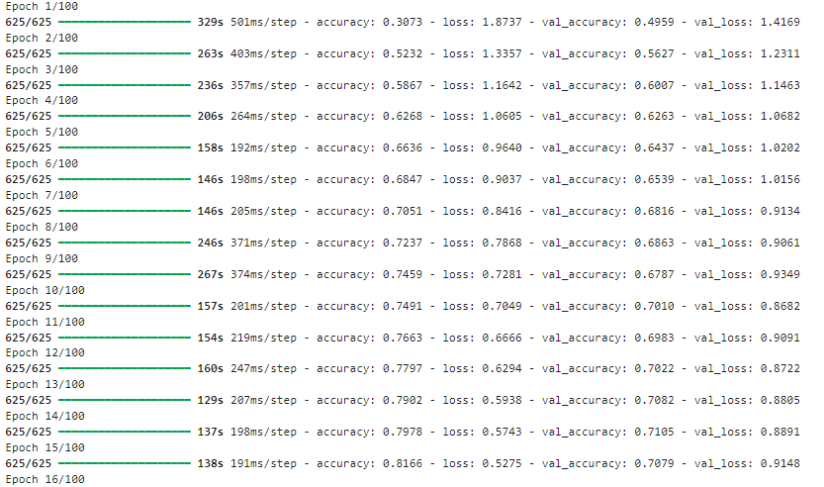
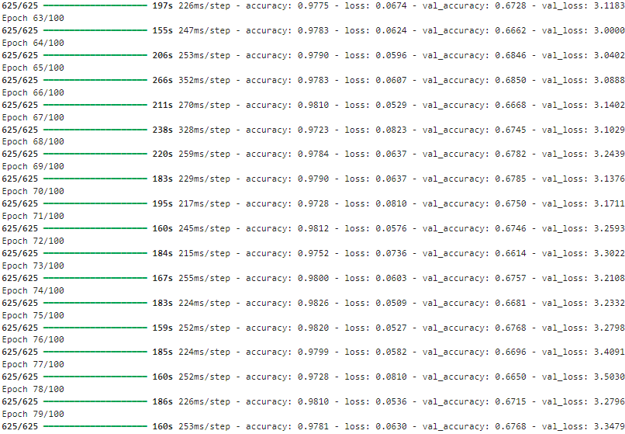
Training & Testing

Slide 25
05
Implement transfer learning using a pre-trained model (e.g., VGG16, ResNet) for image classification.

Slide 26
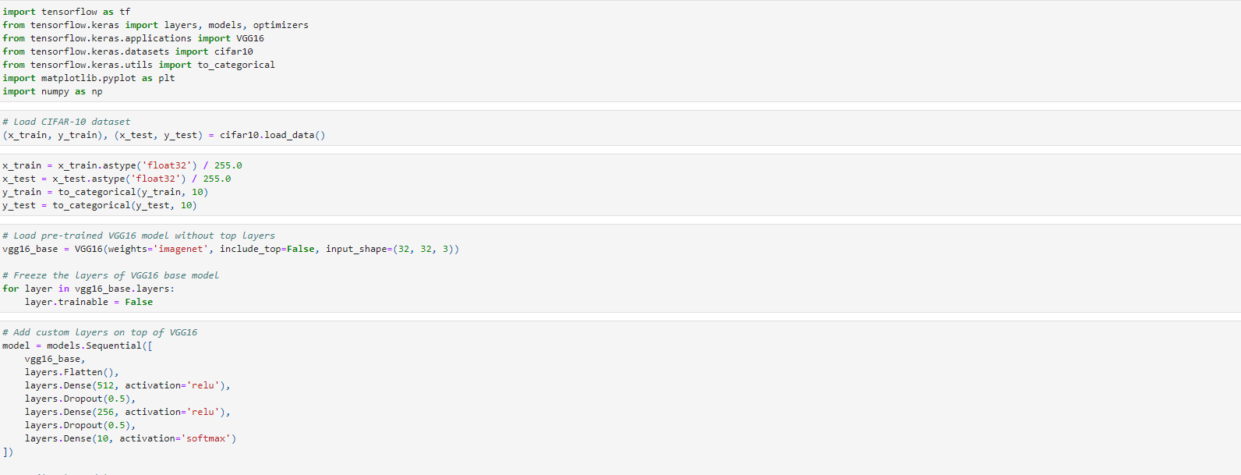
Importing Data
Model Building

Slide 27
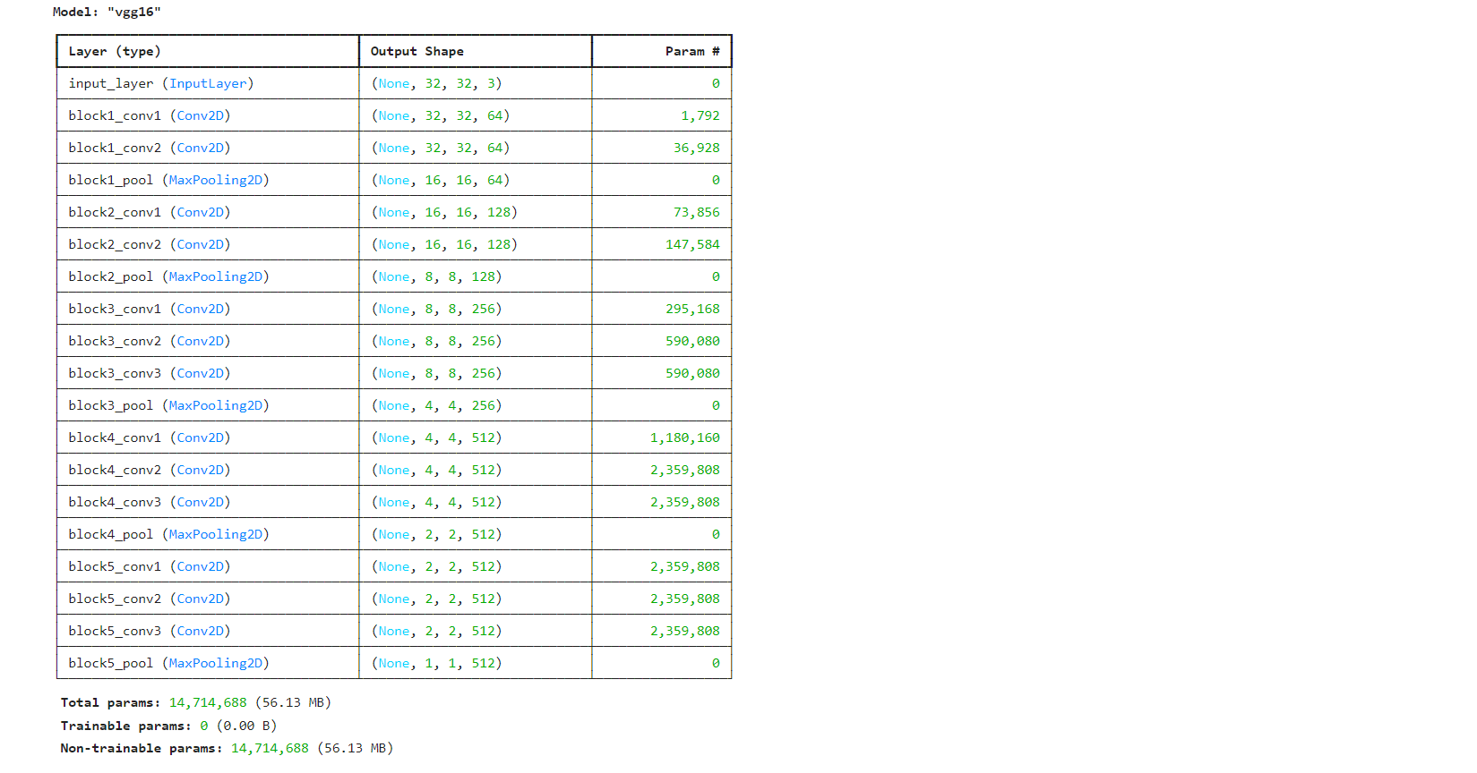
Model Summary

Slide 28
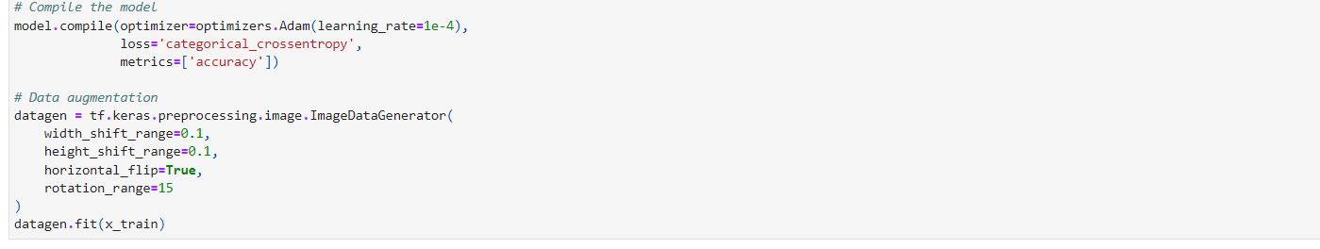
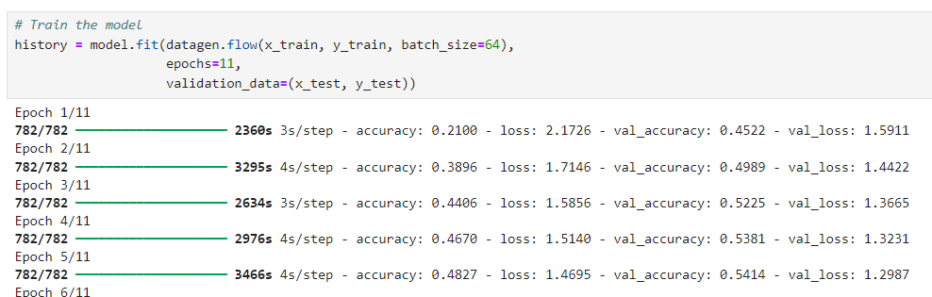
Training & Testing

Slide 29

THANK'S FOR WATCHING
Regards,
ABDULLAH IMRAN

